Slide 1

CARAVAN
INSURANCE
GROUP 18 course work A
RAIHAN ABU JAFAR(6775385)
YOHANI THANUSHA(6780252)
VYSALINI NAIR(6780560)
PAVITHRA NAGARAJAN(6781821)

Slide 2



ABOUT CARAVAN INSURANCE
A policy from an insurance provider called “Caravan insurance" gives customers the broadest insurance protection possible, safeguarding their finances if their caravan is stolen or damaged.

Slide 3





BACKGROUND OF THE STUDY
AIM
DATA SET
AIMs
DATA SET
METHODOLOGY
Source: Dutch Data Mining Company Sentinel Machine research
9822 records : 5822 Training Data and 4000 Test Data
86 Attributes :
◦1-43 socio demographic
◦43-86 Product ownership
To predict the customers who will buy the caravan insurance.
To identify the profile of the caravan buyer.
We are employing the three balancing approaches of under sampling, and over sampling since the data is unbalanced.
In each technique, we have taken five different algorithms into consideration. They are -C5,Random Tree, CHAID, Logistic Regression and C&RT

Slide 4

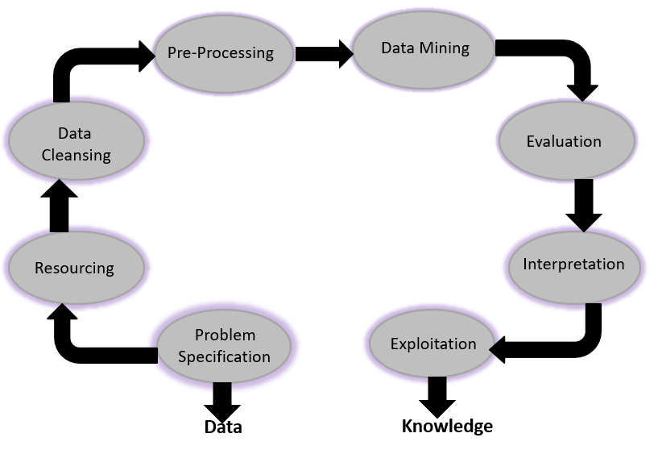
KDD

Slide 5

KDD APPLIED
Problem specification - We analyzed the dataset to determine its features and select software to be used for the purpose.
Resourcing - Gather the resources required for data cleansing, exploration and data mining
Data cleansing – Renaming the column heads, joining target with test dataset and check for null values in the data set.
Data preprocessing – Combination of multiple data source, feature selection and filtering out unimportant fields
CUSTOMERS
Data Mining – Excel, Power BI, R Programing, SPSS modeler
Evaluation – Performance evaluation with test set, confusion metrics and ROI
Interpretation – How closely pattern matches with existing knowledge
Exploitation – Real Life application

Slide 6
DATA VISUALIZATION
Comparisons with caravan:
no of boat policy,
no of car policy,
customer main type,
fire policy,
high-status,
third-party insurance policy

Slide 7
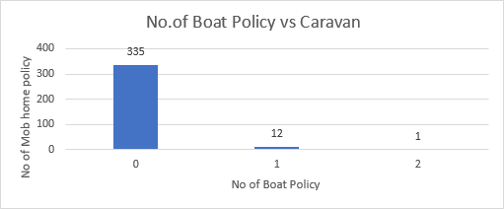
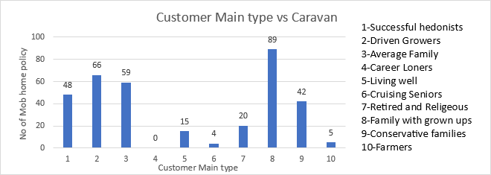
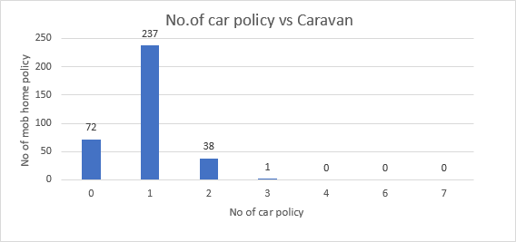
From the figure, it is clear that people who doesn’t have boat policy are buying caravan insurance policy more than the ones who have bought boat policy.
This comparison helps us identify that the families with grown ups are buying caravan insurance compared to other categories of people in terms of the customer main type.
CUSTOMERS
From the figure, it is evident that the people who have 3 or less car policies are purchasing caravan insurance. Out of them, people who have 1 car policy are more interested in buying caravan insurance.

Slide 8
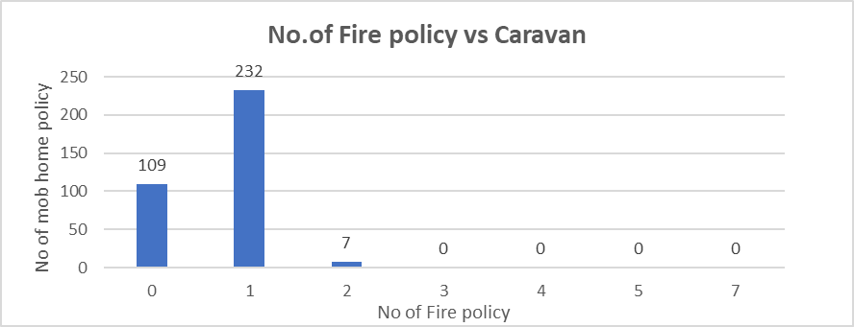
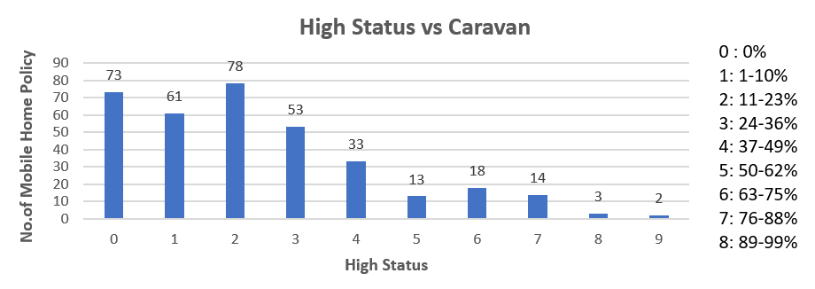
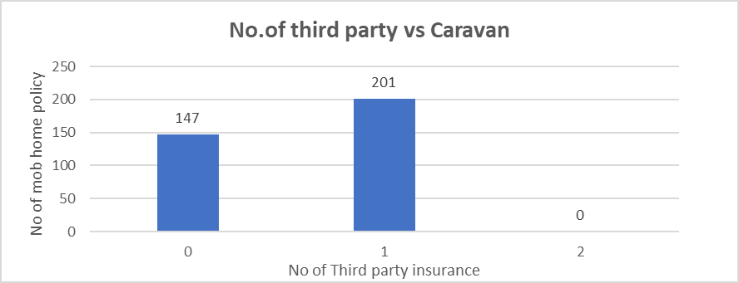
From the figure, it is clearly visible that the people who have less than 2 fire policies are purchasing caravan insurance. Out of that, the people who have 1 fire policy have mainly bought the caravan insurance.
From the figure it can be concluded that, as the level of status increases, there is an overall drop in the people purchasing caravan insurance except in the 1-10% status level.
From the figure, it can be concluded that the people who have only 1 third party insurance policy or no third party insurance policy are purchasing caravan insurance.

Slide 9
FEATURE SELECTION
Applying the feature selection model found in IBM SPSS modular's modeling section help us to decrease the number of input fields and improve any model's performance. This modelling technique helps us get valuable data by lowering the field value that is set as an input.
Fields that are very helpful in attaining the intended output are frequently obtained through feature selection. A very big dataset of caravan insurance with thousands of predictors is ranked by the feature selection node, which then obtains the most important field values.
The goal of feature selection is to help us create a model that is quicker and better organized, especially one that employs fewer predictions, is simple to comprehend, and most importantly, takes less computation.

Slide 10
Here we have selected features based on their predictor importance value >= 0.9 from Pearson correlation technique.
Contribution Car Policies
Contribution Fire Policies
Number of Car Policies
Number of Boat Policies
Customer Main Type
Purchasing Power Class
Contribution Private Third-Party Insurance
Average Income
Number of Private Third-Party Insurance Policy
Customer Subtype
Lower-Level Education
Income < 30,000
Social Class A
Rented House
Home-Owners
High Level Education
Number of Social Security Insurance Policies
Number of Fire Policies
No Car
High Status
Income 45-75,000
1 car
Social Class C
24. Skilled Labourers
25. Married
26. Number of Moped Policies
27. Social class D
28. Other Relation
29. Income 75-122,000
30. National Health Service
31. Middle Management
32. Private Health Insurance
33. Number of Life Insurances
34. Unskilled Labourers
35. Average Size Household
36. Protestant
37. Number of Bicycle Policies
38. Number of Family Accidents Insurance Policies
39. Social Class B1
40. Farmer
41. No Religion
42. Medium Level Education
43. Singles
44. Other Religion
45. Number of Surfboard Policies
CUSTOMERS

Slide 11
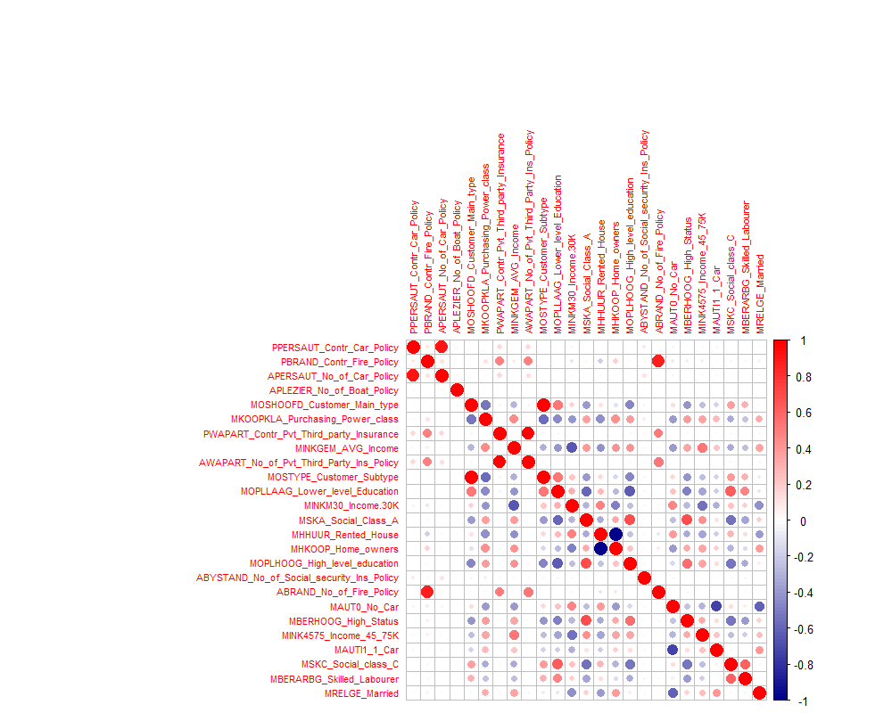
CORRELATION
The below heatmap shows a correlation between the selected fields (after feature selection). Several strong relations were detected on the chosen features whose significance cannot be neglected just because it has good correlation coefficient value with each other.
CUSTOMERS

Slide 12
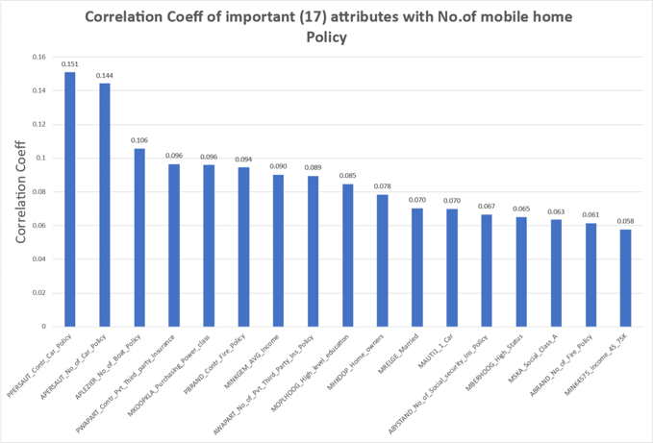
Correlation Coeff of important (17) attributes with No. of mobile home Policy

Slide 13
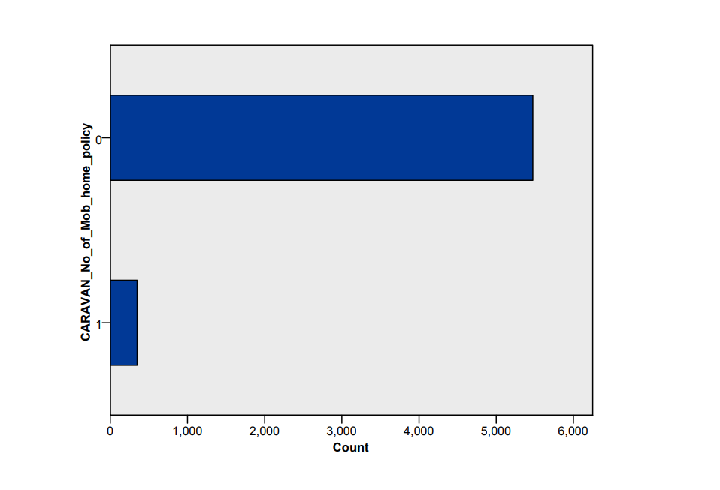
DATA BALANCING
The caravan Insurance data set is an imbalanced dataset where only around 5% people are buying caravan insurance and 95% is not buying. Such imbalance in dataset cannot generate good predictive models.
Therefore, we have used balance node to under sample the majority data and oversample the minority data.
We had to be cautious about the overfitting issue of minority data to avoid biasness. We have used 3 different balancing techniques for modeling, which are 65%-35% , 70%- 30%, 75%-25%.
95%-5%

Slide 14
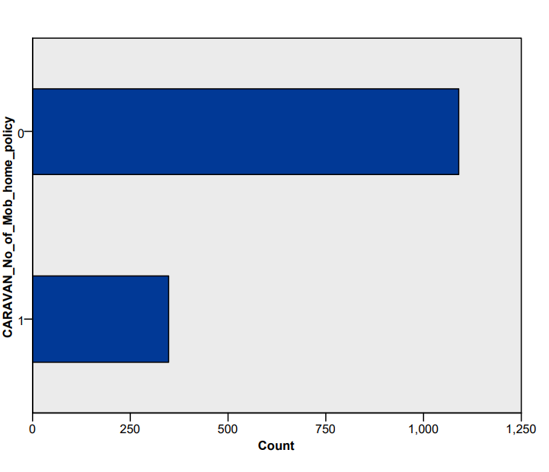
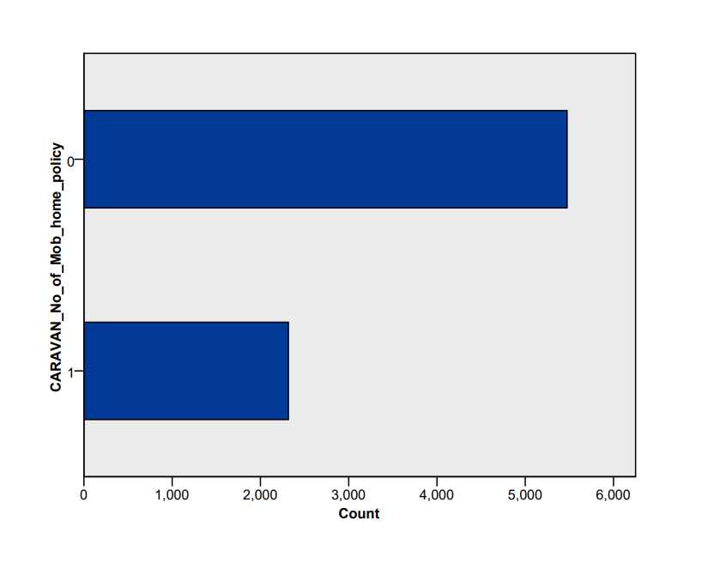
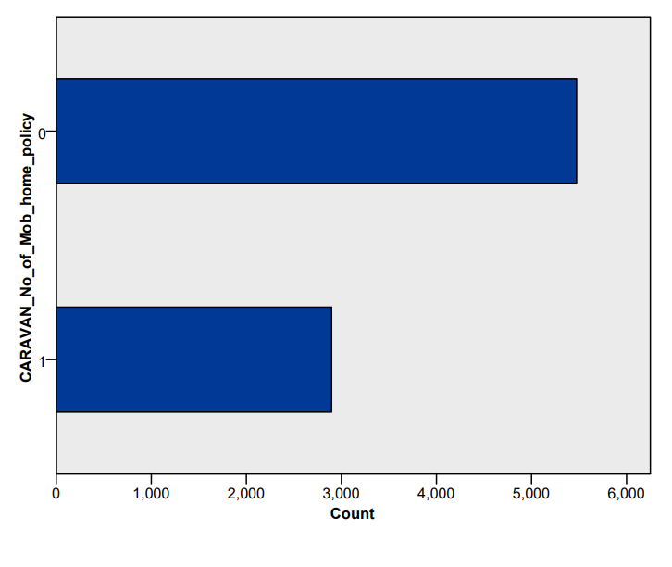
75%-25%
70%-30%
65%-35%

Slide 15



DATA MINING
To analyse the data and build the customer profile of the buyers of the Caravan Insurance, 5 data mining algorithms were used under each data balancing proportions which were discussed in the previous slide.
The models used are; C5, Random Tree, CHAID, Logistic Regression and C&RT.
Random Tree is a machine learning algorithm which help in classifications where it represents decisions and potential outcomes using a tree-like structure.
CHAID (Chi-square Automatic Interaction Detector) is an algorithm used for identifying relationships between a categorical response variable and other categorical predictor variables.
C5.0 is a decision based algorithm which is used for identifying patterns that can be ultimately used for prediction.
C5
RANDOM TREE
CHAID

Slide 16


Logistic Regression is a machine learning algorithm which is used for the classification issues. It is a predictive analysis algorithm and probability based concept.
The C&R Tree algorithm is a data mining and predictive modelling technique which is able to handle both categorical and continuous predictor variables, and can be used for both classification and regression tasks.
LOGISTIC REGRESSION
C&RT

Slide 17
PREDICTIONS
This will show the most accurate models under the 3 proportions used; 65%-35%, 70%-30%, 75%-25% to attain the best results

Slide 18
The Analysis of the Models Output

Slide 19
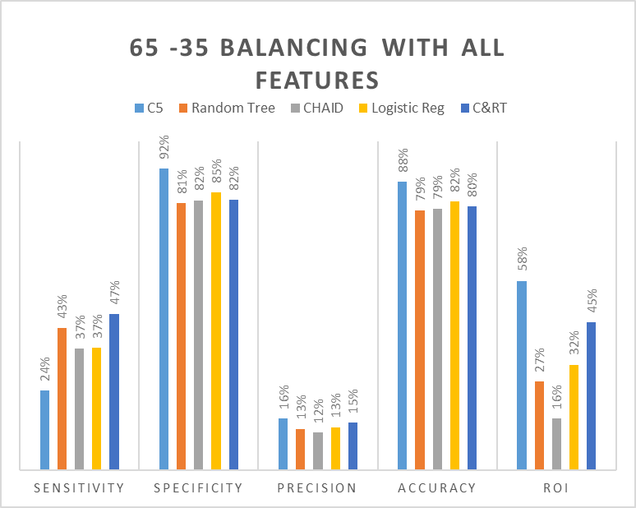
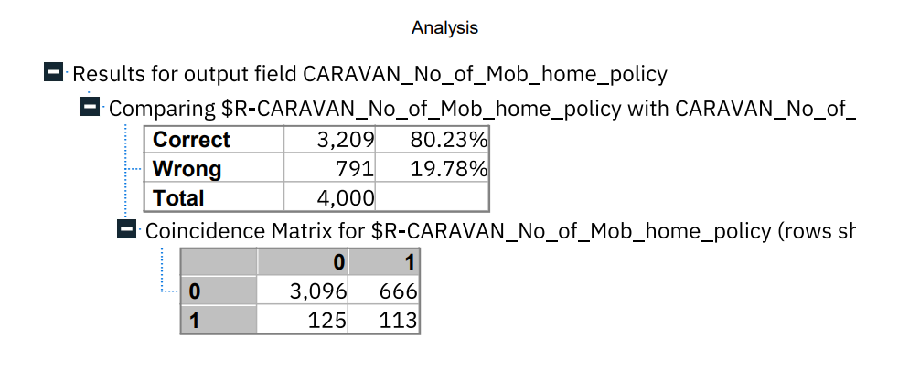
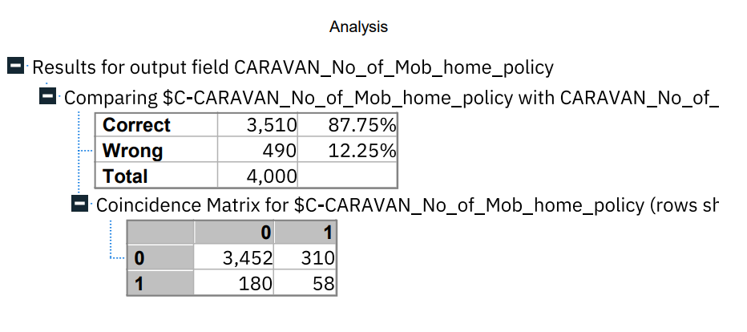
65-35 Balancing with all features
-C&RT-
-C5-
CUSTOMERS

Slide 20
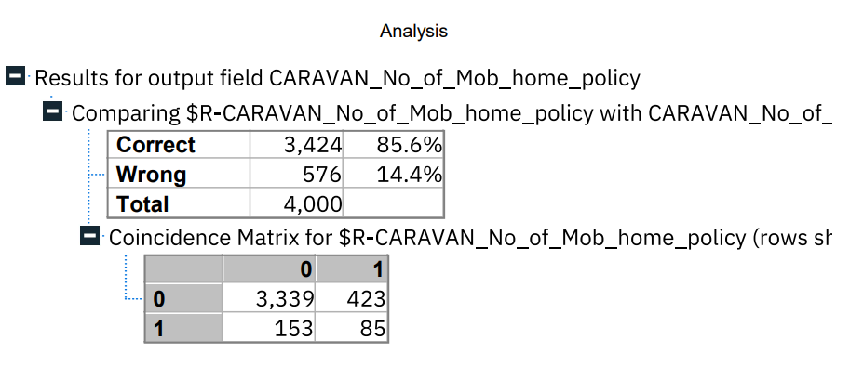
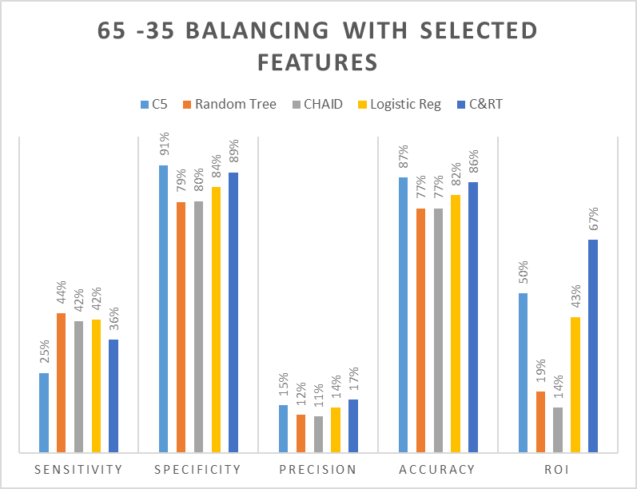
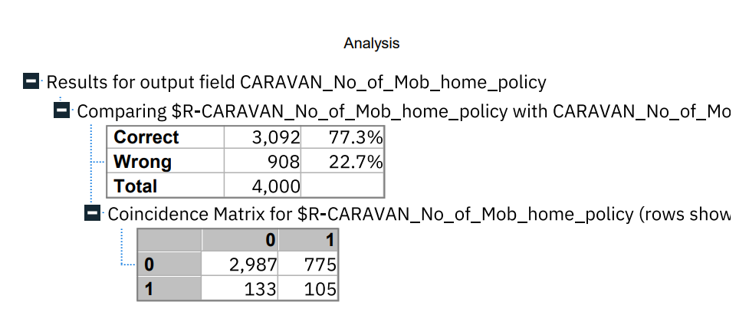
65-35 Balancing with selected features
-C&RT-
- Random Tree-

Slide 21
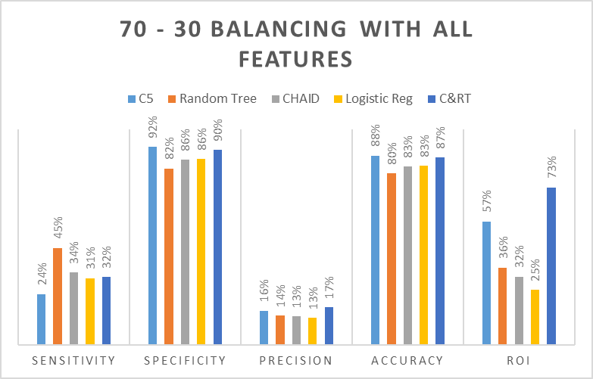
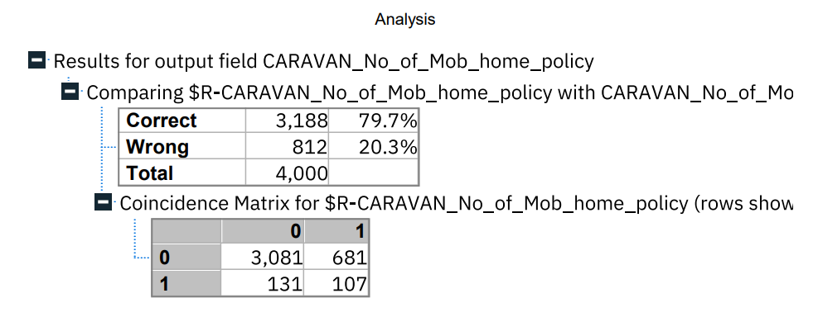
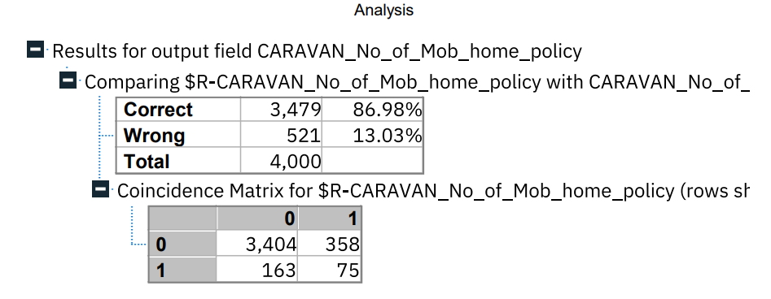
70-30 Balancing with all features
-Random tree-
-C&RT-
CUSTOMERS

Slide 22
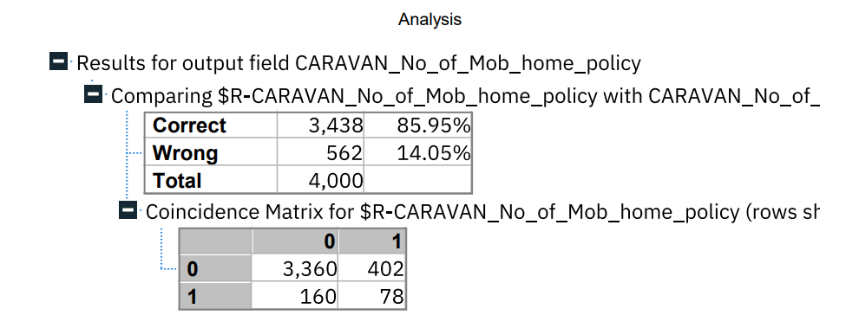
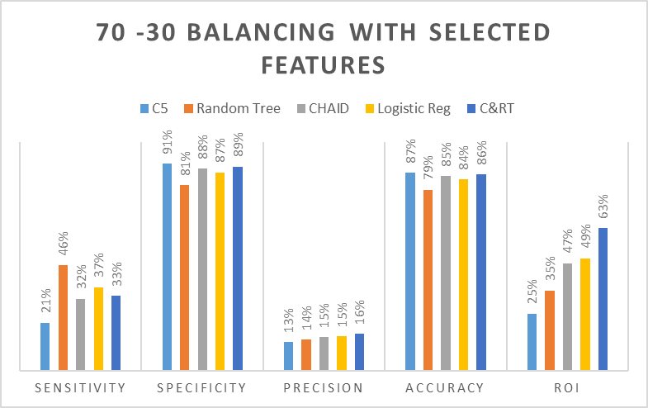
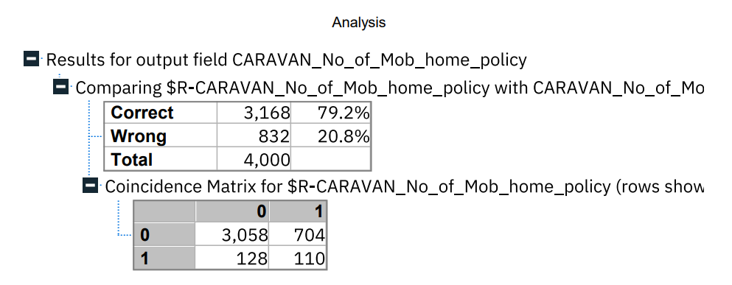
70-30 Balancing with selected features
-C&RT-
-Random Tree-

Slide 23
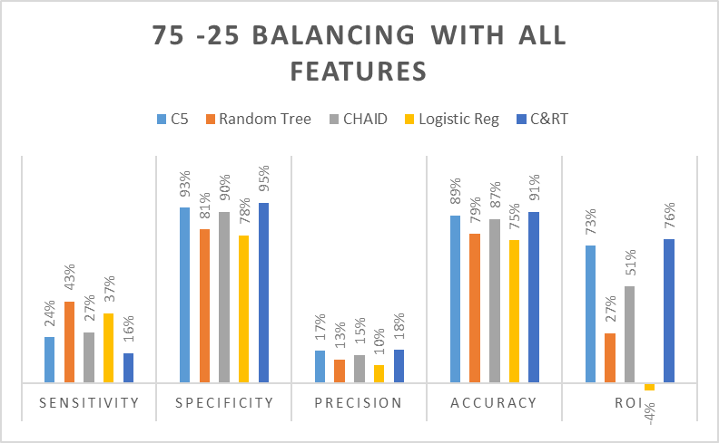
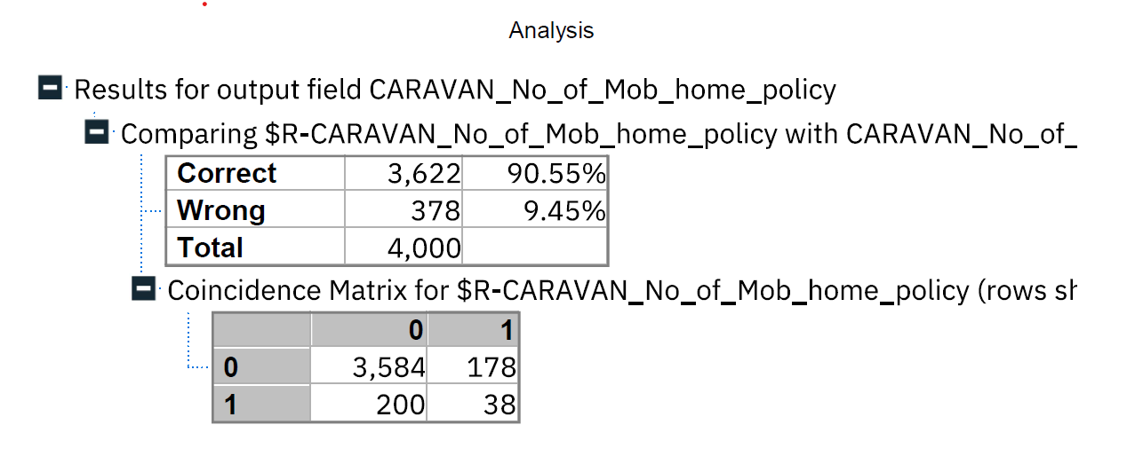
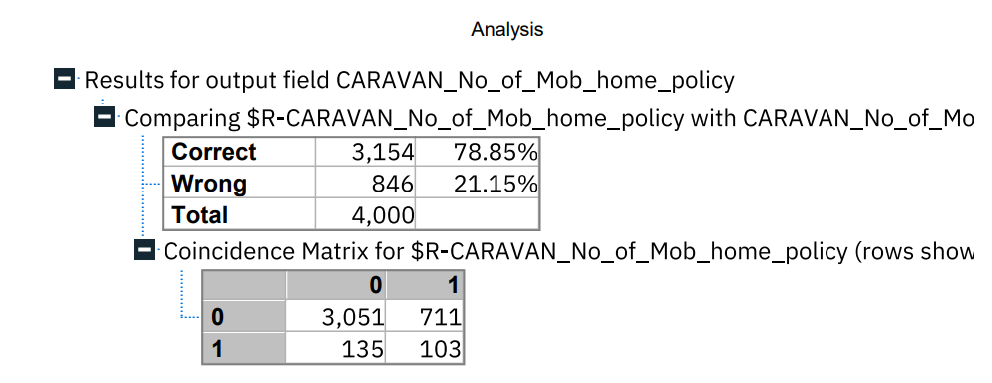
75-25 Balancing with all features
-C&RT-
-Random Tree-

Slide 24
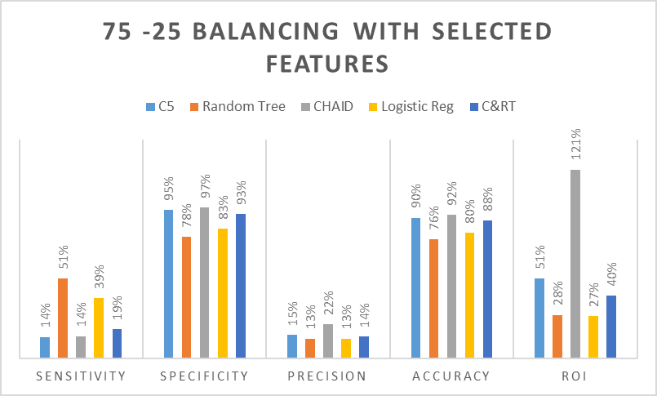
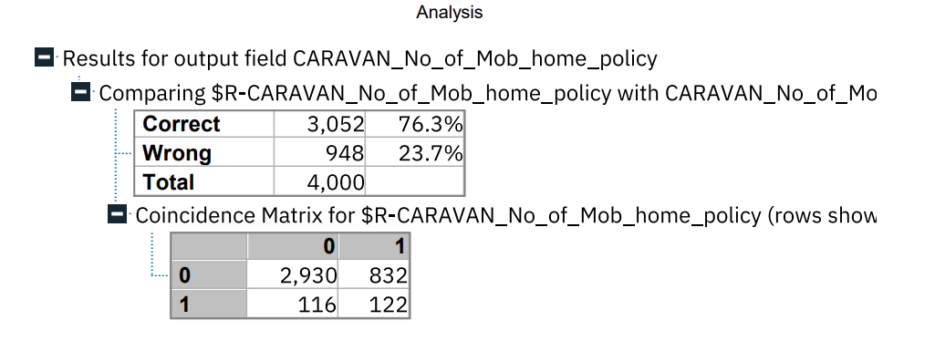
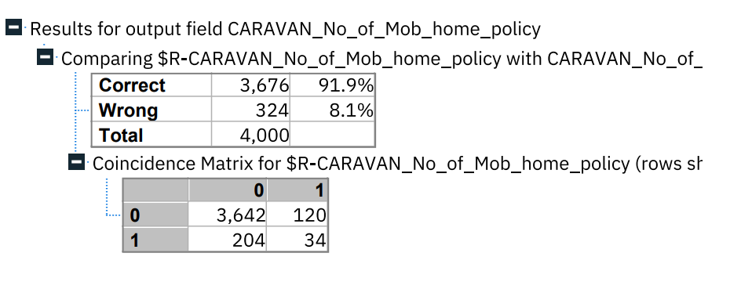
75-25 Balancing with selected features
-Random Tree-
-CHAID-

Slide 25
R0I
Calculation
ROI= (Total Revenue – Cost of Investment) ÷ Cost Of Investment
Total Revenue = (TP) * Cost of insurance
Total Expenditure = (TP+FP) * cost of insurance
Cost of a car policy in U.K (average) = £657 (Jamie Gibbs, 2023)
Cost of each customer acquisition = 10% of cost of the policy
ROI stands for Return on Investment. It is a financial metric used to measure the efficiency and profitability of an investment. ROI is calculated as the ratio of the net profit or gain from an investment to the total cost of the investment. It is usually expressed as a percentage. A higher ROI indicates that the investment is more profitable, while a lower ROI indicates that the investment is less profitable. ROI is commonly used by businesses to evaluate the potential returns of different investment opportunities and make informed decisions about where to allocate their resources.

Slide 26

CUSTOMER PROFILE
CUSTOMERS

Slide 27
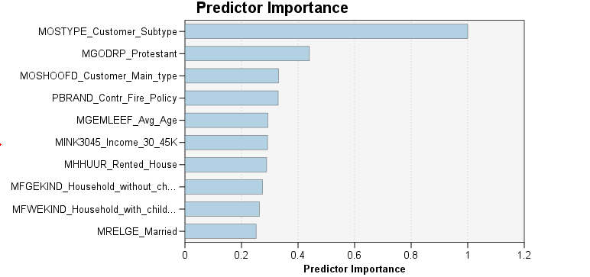
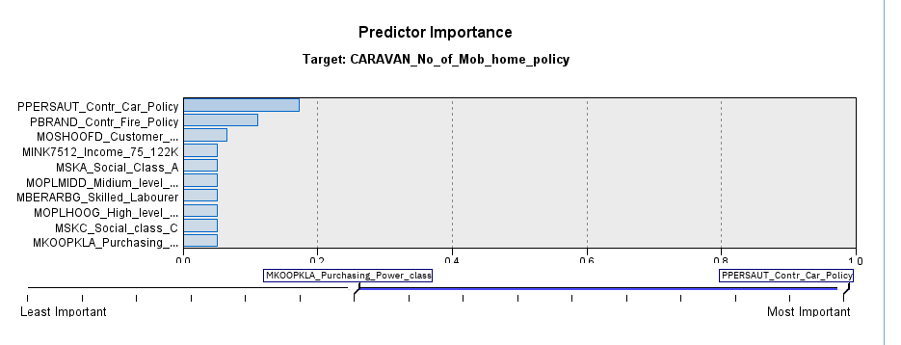
Random Tree Analysis
This predictor importance graph helps us to determine the customer profile by selecting variables which are highly important. The model has picked top 10 attributes based on the impact range.
C&RT Analysis
Used these results to develop customer profile, based on the most predictive variables from the model. This involves identification of specific characteristics or actions of caravan (No.of mobile home policy) customers.

Slide 28

INSIGHTS
•People who are contributing £500 to £4999 in car policies are also buying caravan policy.
•People from social class A, B1 and C are likely to buy Caravan policy.
•Families with grown-ups, driven growers are buying caravan policy, whereas career loners are not buying at all.
•People having income less than 30k and those who have income with in 75k-122k are likely to buy caravan policy.
•From the five Algorithms we have identified that Random tree is giving highest sensitivity with maximum true positives with lower return on investment. On the other hand, C&RT is giving highest Specificity with a smaller number of false positives are giving maximum ROI, at the same time true positive numbers are low.
•As with True Negative customers, management can save time, money, and resource as they are not potential buyers.
•Marketing Team can utilize the False Positive cases from the model to cover large audience and high chance of converting them as potential buyers.
PROJECT 3
PROJECT 1
PROJECT 2

Slide 29
RECOMMENDATIONS
With the results of the models and with more precise target segments, the marketing team can run campaigns. Better return on investment is possible with them. As the cost of acquiring a customer in this caravan insurance case is not high (10% of the cost), management may decide to select the model that yields the greatest number of actual customers (True positives) even though the number of False positives are also substantial. An alternative is to select the model with the highest specificity and highest ROI when taking a conservative investment approach.

Slide 30
THANK
YOU!

Slide 31
REFERENCES
IBM. (n.d.). IBM SPSS Decision Tree. Available at: https://www.ibm.com/uk-en/products/spss-decision-trees(Accessed:13/04/2022)
Xiao, X., Xu, H., &amp; Xu, S. (2015). Using IBM SPSS modeler to improve undergraduate mathematical modelling competence. Computer Applications in Engineering Education, 603-609.
Confused (2023) Has car insurance gone up in 2023? Available at: https://www.confused.com/car-insurance/guides/has-car-insurance-gone-up ( Accessed:12/04/2023)
Statista (2023) Average car insurance cost in the United Kingdom (UK) in 2022, by age. Available at: https://www.statista.com/statistics/751199/average-car-insurance-cost-by-age/ (Accessed:13/04/2022)
Money Helper(2023) What is the average cost of car insurance?https://www.moneyhelper.org.uk/en/blog/car-insurance/what-is-the-average-cost-of-car-insurance(Accessed:13/04/2022)

Slide 32
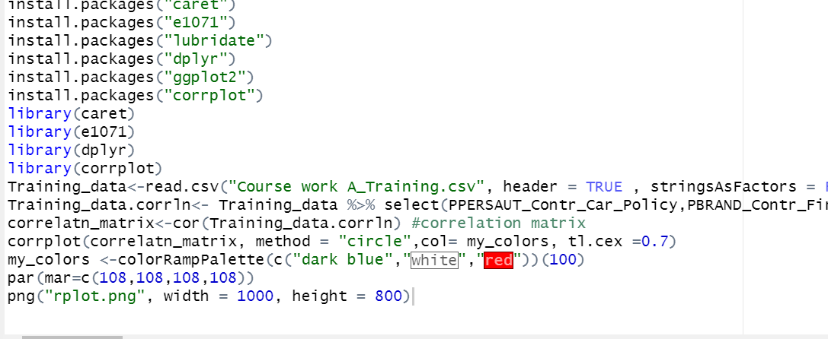
APPENDIX
1. R code to explore heatmap after feature selection

Slide 33
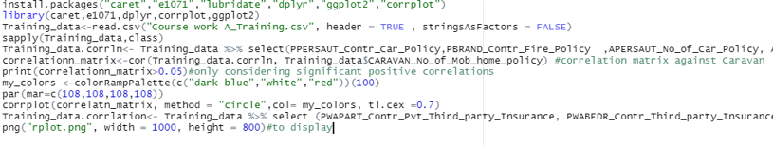
2. R code for Correlation Coeff of important (17) attributes with No. of mobile home Policy

Slide 34
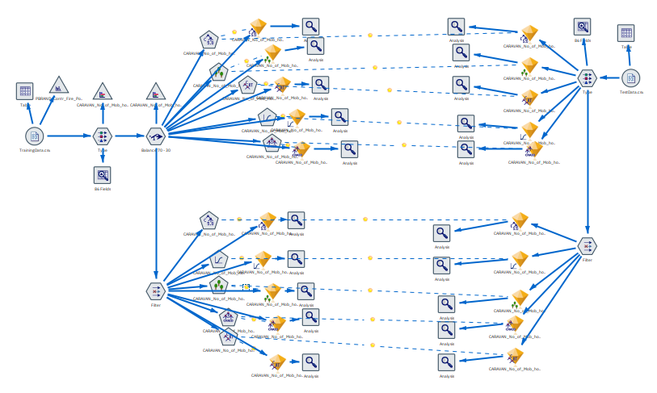
3. The SPSS Models
70-30 Balancing with all features and selected features

Slide 35
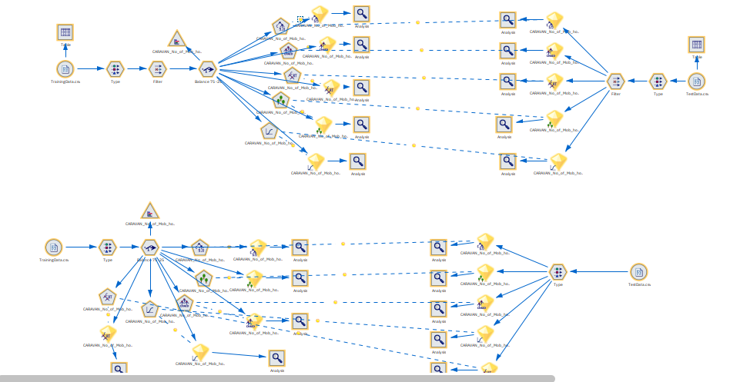
75-25 Balancing with all features and selected features

Slide 36
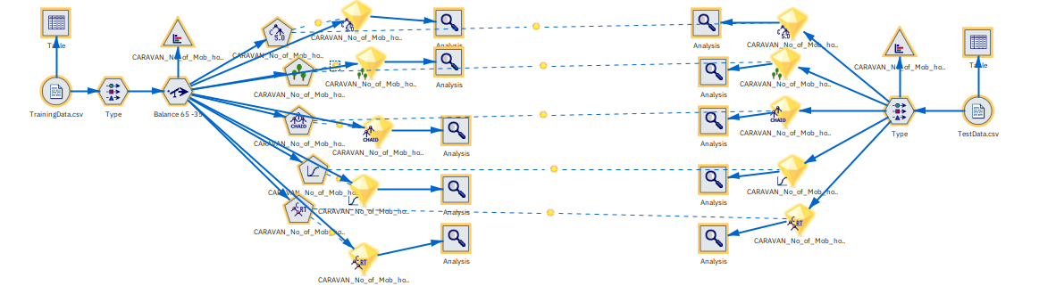
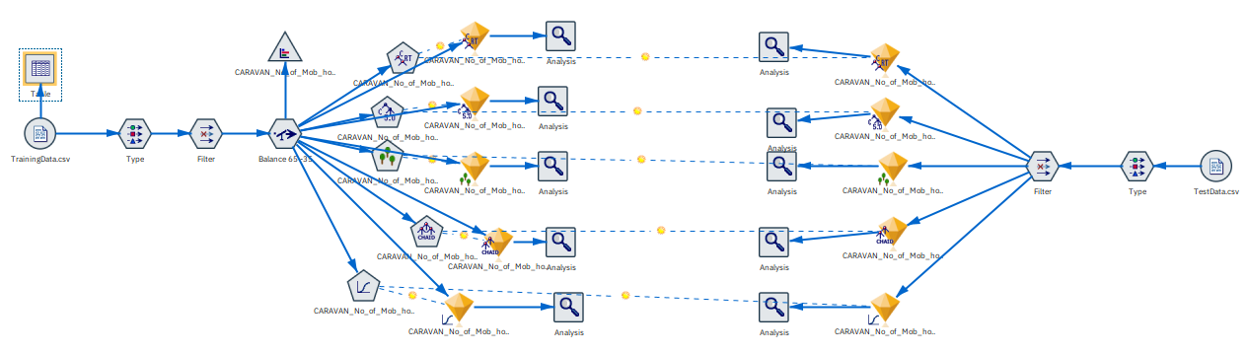
65-35 Balancing with all features and selected features

Slide 37
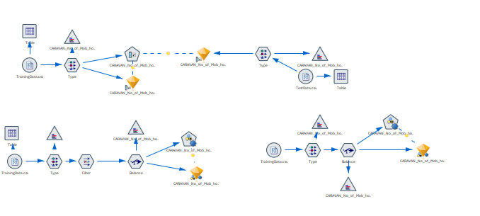

Slide 38
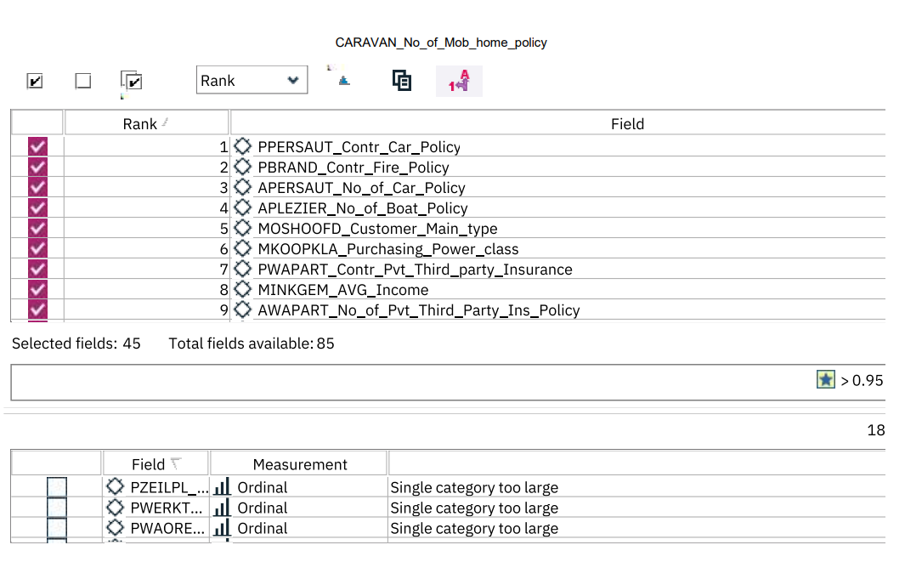
4. The feature selection

